Slide 1

Pillai College of Engineering, New Panvel
Department of Computer Engineering
A Presentation on
DS Mini Project Sem VII
2027 Cricket World Cup Match Prediction using Machine Learning and Data Science
Autonomous
A707 Amarjit Babu M.J
A711 Shivam R. Bandal
A714 Shivom Bhattacharjee

Slide 2
Outline
Introduction
Objectives
Need of the Project
Methodology
Model Evaluation
6. Dashboard
Applications
Future Scope

Slide 3
Introduction
The aim is to build a model to predict 2027 Cricket World Cup match outcomes using ODI rankings and past performance data.
ODI rankings, matches played, won, lost, tied—these metrics highlight team form and strength.
Use machine learning algorithms (e.g., decision trees, logistic regression) for accurate predictions.
Real-time match analysis, strategy planning, and data-driven predictions for teams and fans.

Slide 4
Objectives
Predict match outcomes for the 2027 Cricket World Cup using ODI rankings and historical match data.
Analyze team performance based on metrics like matches won, lost, and tied.
Apply machine learning models to enhance prediction accuracy.
Support real-time match analysis and strategic decision-making for teams and fans.
Incorporate additional factors like venue conditions, player form, and head-to-head records to improve prediction accuracy.
Continuously update and refine the model with new data to maintain high accuracy throughout the tournament.

Slide 5
Need of the Project
Opponent Analysis: Helps teams analyze the strengths and weaknesses of their opponents, allowing them to tailor game strategies to exploit vulnerabilities.
Home and Away Performance Insights: Provides teams with data on their historical performance in home versus away matches, aiding in the development of effective strategies based on venue-specific conditions.
Tactical Adjustments: Enables teams to make tactical adjustments by understanding trends, such as which bowling or batting strategies have worked against specific teams historically.
Momentum Tracking: Assesses a team’s momentum throughout the tournament by tracking wins, losses, and performance patterns, helping teams adjust their preparation and approach in crucial stages.

Slide 6
Methodology
Data Collection and Preprocessing: Gather historical match data, ODI rankings, and venue details, then clean and normalize for consistency.
Feature Engineering: Identify and select relevant features like team form, venue performance, and head-to-head records to improve model accuracy.
Model Development: Use machine learning algorithms such as Random Forest and Logistic Regression to build a predictive model.
Model Evaluation and Optimization: Assess model performance using metrics like accuracy and optimize parameters through techniques like cross-validation.
Deployment and Real-Time Predictions: Deploy the model on a cloud platform for real-time analysis and live match predictions.
Model Maintenance and Updates: Continuously update the model with new match data and refine it based on ongoing performance.

Slide 7
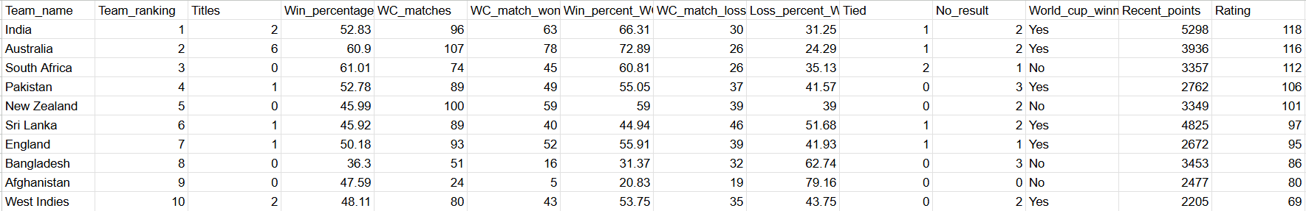
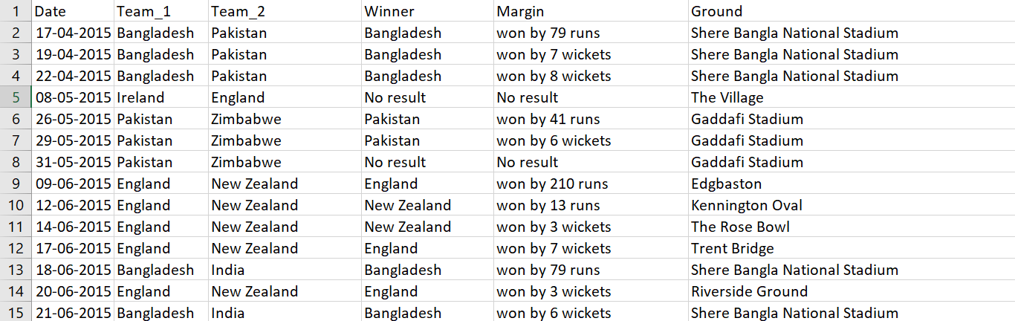
Model Evaluation
Datasets
I)Oddi Rankings
II)Results

Slide 8
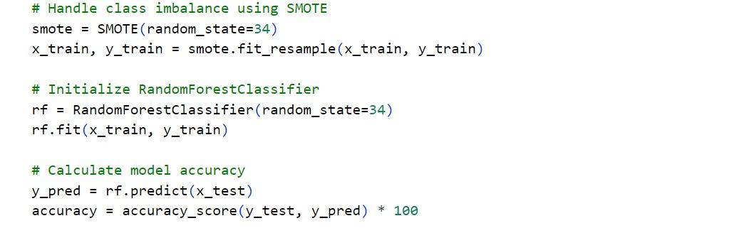
Model Evaluation -2
2. Model Evaluation Algorithm

Slide 9
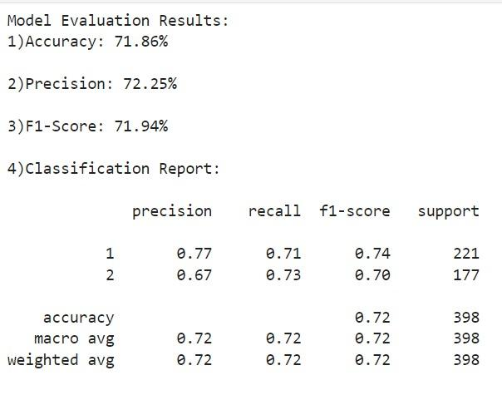
Model Evaluation -3
3. Model Accuracy and Precision

Slide 10
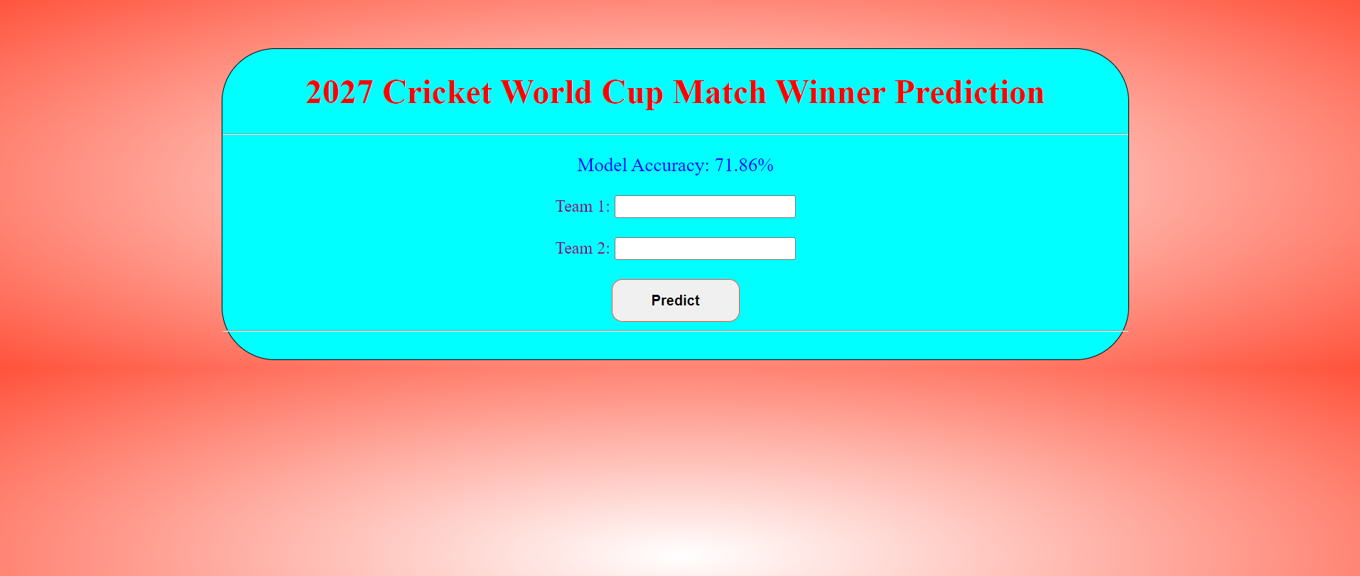
Model Evaluation -4
4. GUI Input

Slide 11
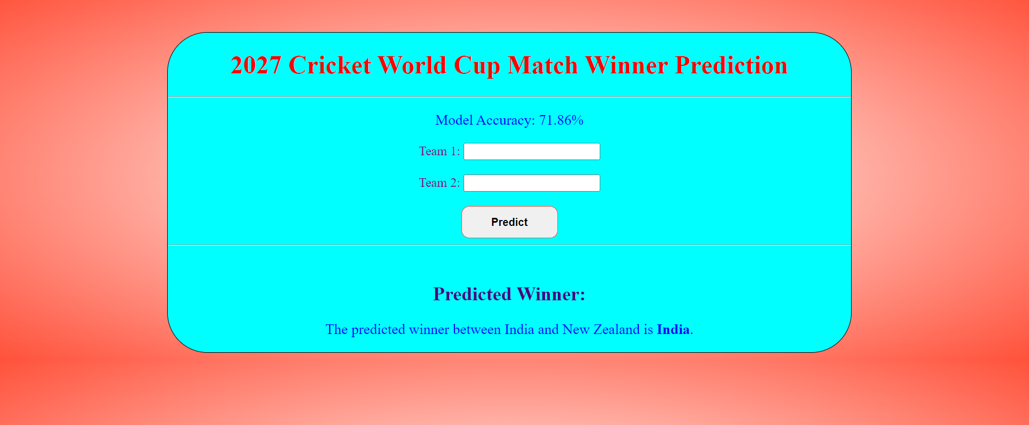
Model Evaluation -5
5. GUI Output

Slide 12
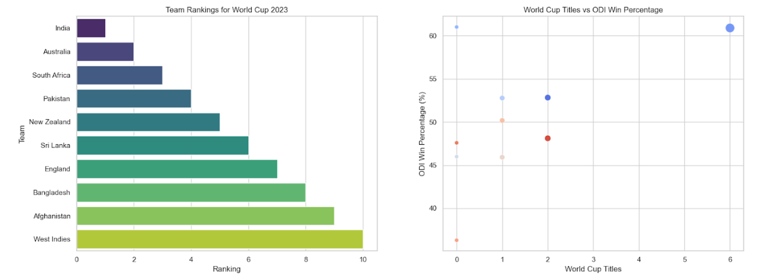
Dashboard

Slide 13
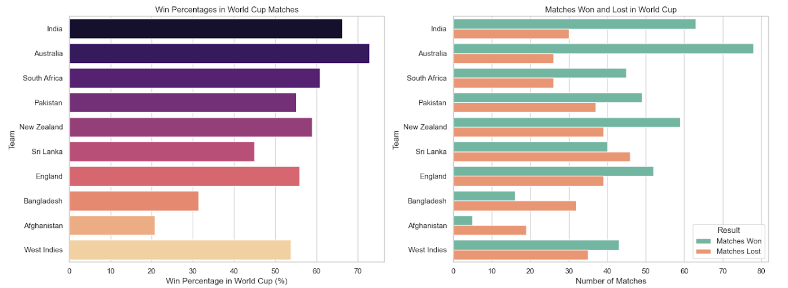
Dashboard -2

Slide 14
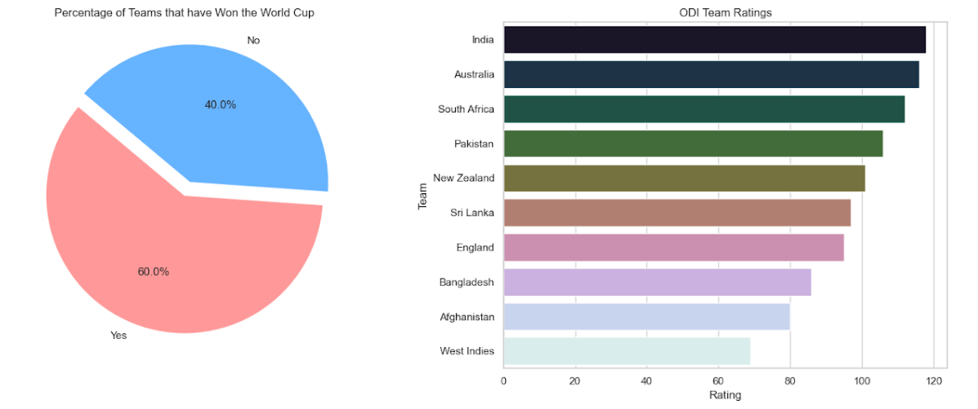
Dashboard -3

Slide 15
Applications
Match Outcome Prediction: Accurately forecast the results of 2027 Cricket World Cup matches based on data-driven analysis.
Team Strategy Optimization: Help teams develop tailored strategies by analyzing opponent strengths, weaknesses, and historical match data.
Performance Monitoring: Track team performance trends in real-time, offering insights for tactical adjustments during the tournament.
Fan Engagement: Enhance the viewing experience by providing fans with interactive predictions and analytics for each match.
Broadcast and Media Analysis: Assist broadcasters and media analysts with data-backed insights for pre-match discussions and in-game commentary.

Slide 16
Future Scope
Real-Time Adaptation: Enhance the model to provide live predictions that adapt to ongoing match conditions, such as player performance and weather changes.
Expansion to Other Formats: Broaden the scope of predictions to include T20 and Test matches, allowing for a comprehensive analysis of cricket across all formats.
Integration of Advanced Analytics: Incorporate more sophisticated analytics, including player metrics and situational performance, to refine predictions and insights further.
User Personalization: Implement features that tailor predictions based on individual user preferences and historical engagement, improving the overall user experience.
Commercial Applications: Explore monetization strategies, such as subscription services for detailed analytics, catering to fans, analysts, and cricket organizations.

Slide 17


